Slide 1

January 2023
NCL STUDENTS’
ASSOCIATION &
LEARNER ENGAGEMENT
Board Report

Slide 2

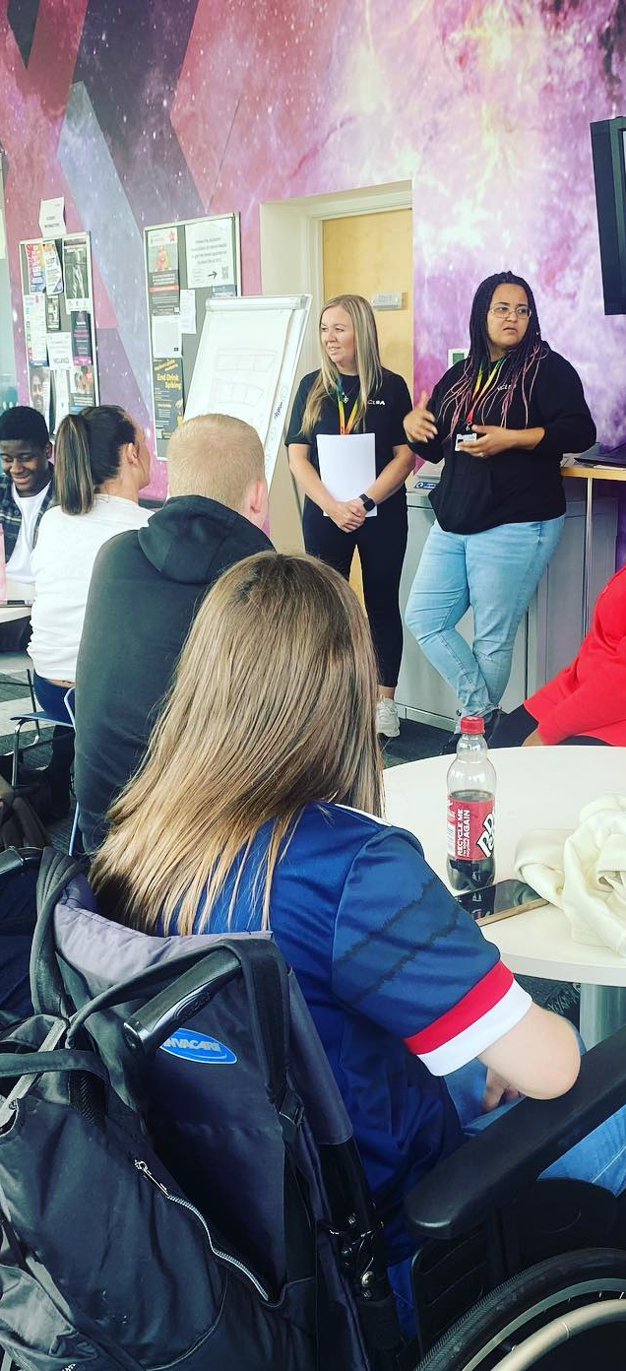
Re-freshers’
23.
Time to re-charge batteries and have fun with friends.
At NCL we are committed to ensuring that our students’ get the most from their college experience.
Re-Freshers‘ 23 was focused on providing a warm and welcoming experience for new and existing students. Encouraging all to have fun, relax and practice self-care, as well as gain access to information and resources that might help them during their time at NCL.
We partnered with local and national organisations who are as passionate as we are about well-being. In addition, NCLs very own departments provided services and entertainment.
The SA on the day ran Boccia, a sport designed for athletes with high support needs, a smoothie bar, ‘beer’ pong and a treasure hunt with a £50 voucher prize.

Slide 3
Student
Pantry.
Throughout the winter period, the NCL community came together to support our students during times of financial hardship. Raising funds and donating goods to NCL’s food pantry initiative.
The success of this initiative has allowed the team to explore how the initiative can be sustained long-term through external funding as the flow of donations can only keep the pantries stocked for more than a few days.
5 opportunities have been identified National Lottery Awards for All Scotland, National Lottery Improving Lives, National Lottery Young Start, ASDA Foundation, Tesco Community Grants – we will work with external funding to start applications.

Slide 4


Raising Awareness.
LGBT Charter and LGBTQ+ History Month
As we arrive to the deadline of the LGBT Charter, the SA are working closely with our EDI Advisor to help gather evidence to achieve the charter.
February marks the beginning of LGBT History Month and the SA have been working with the brand team to showcase historical moment that marks a time in LGBT history.
These moments in history will be displayed on internal screens and college social media platforms.

Slide 5

Student Elections.
The elections this year will be for 2 sabbatical post and a voluntary vice-president for supported learning.
In partnership with the Supported Learning department, we have established the responsibilities and the remit for our future voluntary vice-president for supported learning.
We will host on-campus and online activity to create as much engagement as possible.
NUS will be assisting with the returning officer role. The current SA will feature in videos sharing first hand experience of the roll and the changes they have made since beginning post 2 years ago.
The Brand team will support the communications and marketing of the elections ensuring all students have the opportunity to consider running.

Slide 6
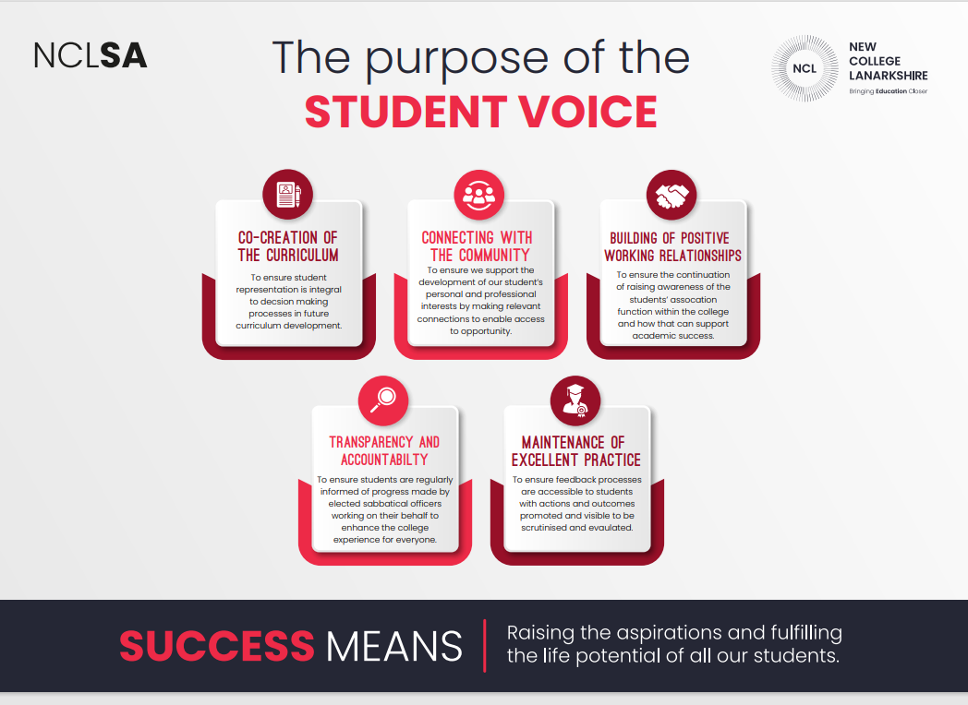
NCLSA Strategy.
The Students’ Association (SA) and Learner Engagement Team completed the strategic plan for the SA and was commended by NUS on how far it has come in the last 2 years.
This strategy outlines our priorities and provides clear guidance and direction towards building a strong effective Student Association.
New officers will embrace and build on the great work underway.

Slide 7
Exploring the
Student Learning Experience.
Justin walker, Development Consultant for SPARQS attending a student workshop at NCL to gather feedback regarding the student experience.
This was well attended with student from across all NCL campuses.
We look forward to reviewing the data collected.

Slide 8
Ongoing
Work.
2023 and beyond
Mental Health
Student Engagement
Student Mental Health Agreement
Disability Sports Club at the Tryst Centre for our supported learning students is now in its 10th week of it’s first 10 week block. Planning for a second block is underway to be up and running by late Feb.
Regular class visits allowing the NCLSA to raise awareness of the support and activity being carried out by the SA
Regular feedback sessions are held, gaining vital thoughts on key topics and overall student experience
Feedback Fridays
Cost of living crisis
Training and Development
Ready to Help committee
Food pantry and Swap Shop
Warm spaces
Lunch vouchers for students in need
Laptop Library
Supporting YoungScot Free travel campaign
First aid training
Skills for supervisors training program
Our work doesn’t stop here!
Boards and Committees
Nursery review team
Health, Safety and Wellbeing
Safeguarding

