Slide 1

Students’ Association
August 2023 Board Report.

Slide 2
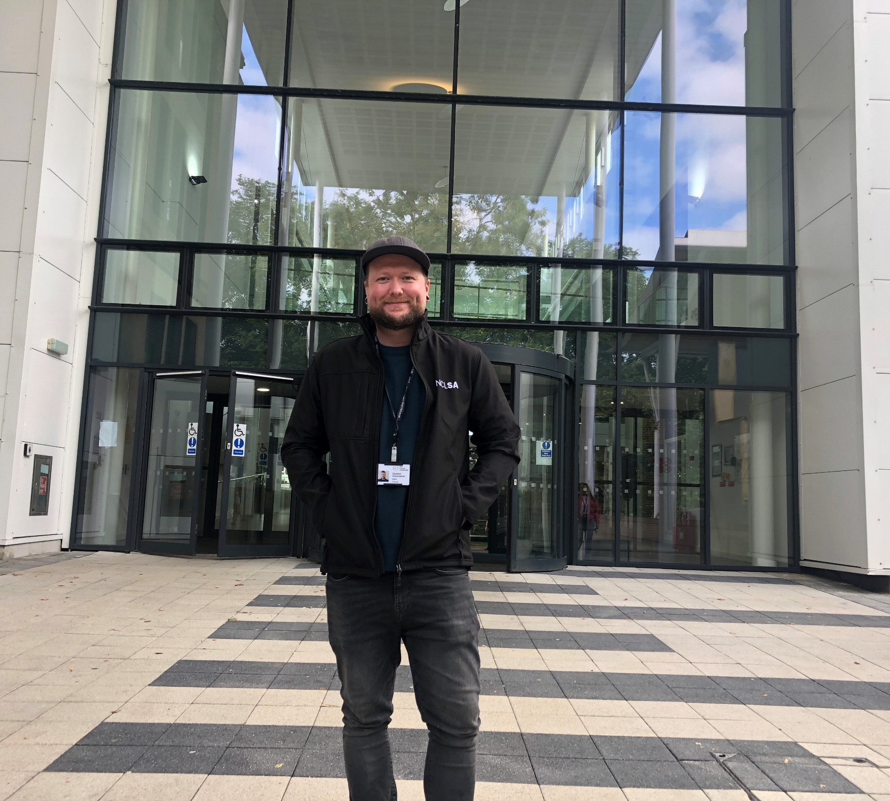
The future is bright.
Meet the NCLSA Student President.
We are delighted to announce that this years Student President has been elected to represent New College Lanarkshire’s Students’ Association (NCLSA) for the 23/24 academic year.
Mark Frame will be the voice of every student at NCL and will work to “make the student experience the best it can be”.

Slide 3
Mark Frame
NCLSA Student President.
Marks priorities are to:
Improve the quality of education at our college by working with staff and faculty to develop innovative and engaging learning experiences.
Increase transparency on our sustainability goals and our race to net-zero by 2042.
Promote diversity and inclusion on campus by working closely with reps to tackle issues experienced by the students whilst also encouraging students to create groups and clubs that appeal to their interests.
I would like to incorporate students more into social media projects to tackle problems facing students. These could be used to showcase the skills of students but also help others who may be struggling.
Enhance student life and celebrate the accomplishments we achieve along the way by organising activities and events which can bring all students together.
These are important issues and Mark is confident that there will be more issues to come, and is committed to tackling these with a fresh perspective and to work with the college and staff to make NCL a better place for all students.
Read Marks full manifesto

Slide 4
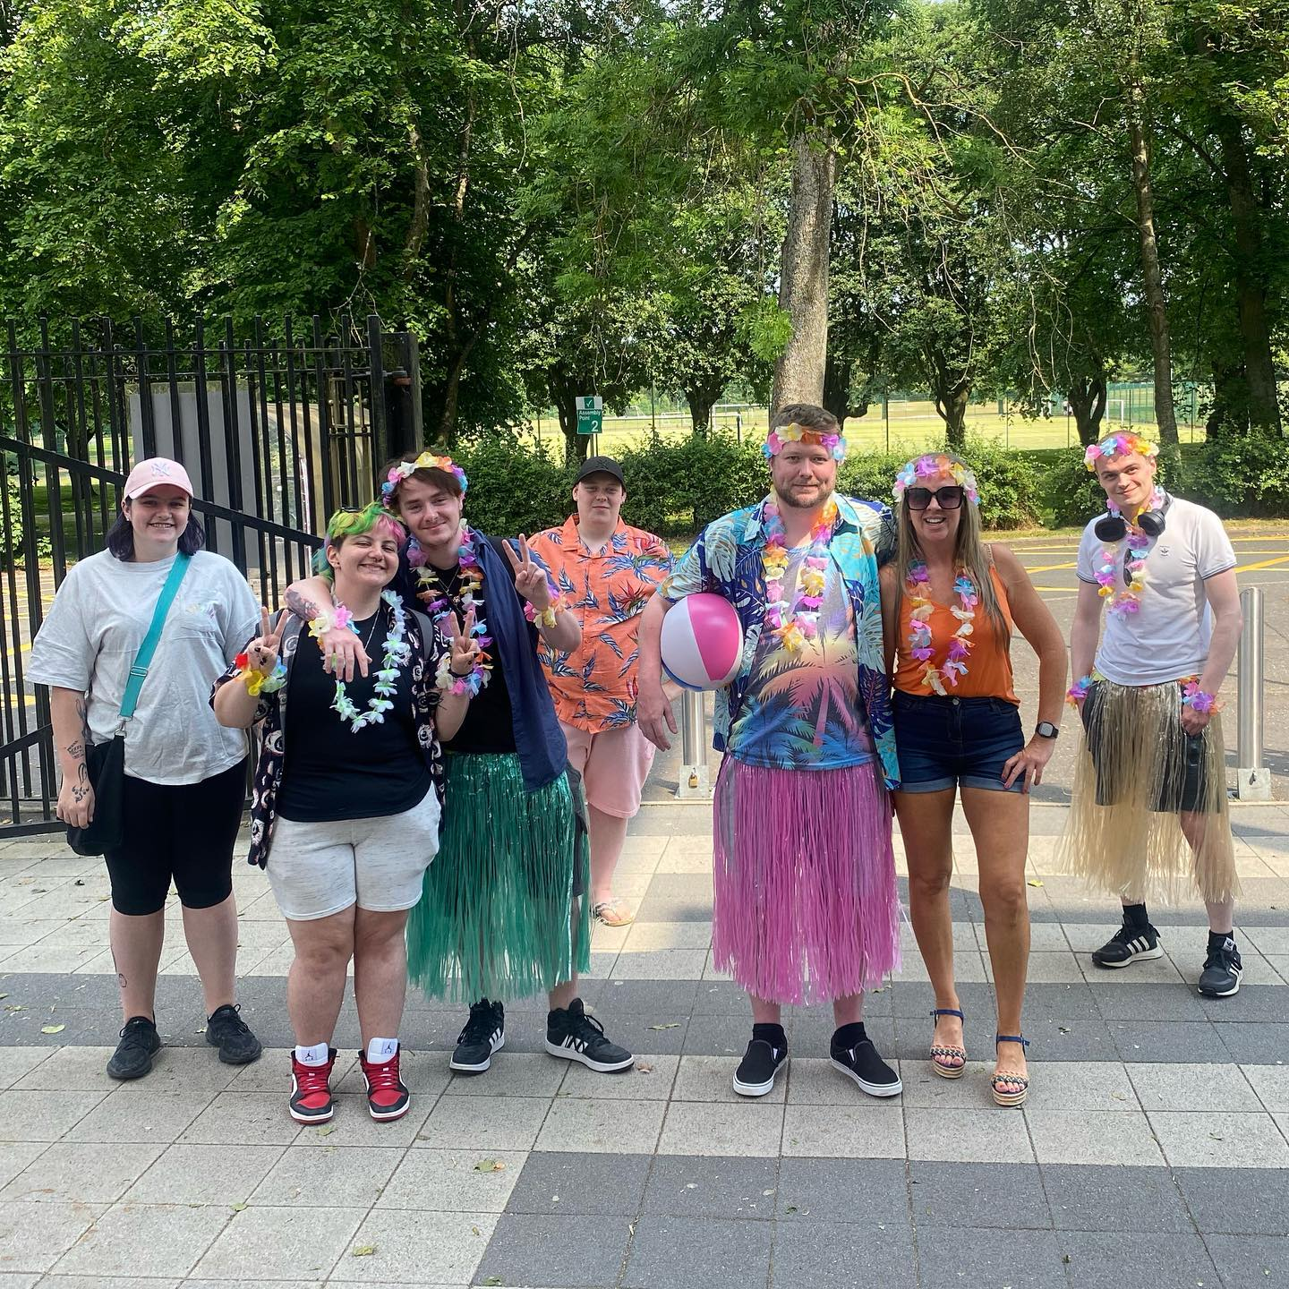
Developing a strong effective SA!
The NCLSA will continue to focus on developing the association around the ‘Framework for the Development of Strong and Effective College Students’ Association. This framework, which has been sector-agreed, focuses on how colleges and students’ association can work in partnership effectively, with the support of sector agencies and the NUS charity.
The framework sets out shared vision for students' association development and has a set of standards and indicators which offer students' associations and colleges a structure and guidance to help them to jointly plan their development.

Slide 5
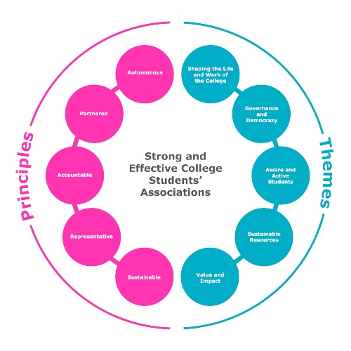
Key Principles and Themes
The Framework aims to provide a shared vision for students' association development and a common understanding of its key concepts and qualities. It identifies five key Principles that set out the aspirations for students’ associations in the college sector. These are:
Partnered
Representative
Sustainable
Accountable
Autonomous
The Themes section outlines five areas of development that colleges and students' associations will need to work together to put in place. These are:
Shaping the Life and Work of the College
Governance and Democracy
Aware and Active Students
Sustainable Resources
Value and Impact.
With the aim to work collectively to develop a strong and effective students’ association, the SA has been involved in sessions over the last year and were involved in three workshops this summer. These workshops were based on how to develop a strategic plan and the team are currently in the process of drafting their strategic plan for 2022-2025.
The team have also agreed on specific KPIs and expected sources of feedback on methods of collection. These are currently awaiting approval by the Executive Board.

Slide 6

That's Quality! Colleges is a quality induction event hosted by sparqs that offers training and guidance to college officers and those who support them. The aim of the event is to help newly elected officers engage in quality processes at college level and to equip them with the knowledge and ability to run an effective students’ association.
This year’s event was split into three parts. The first part was a one-day online event on Thursday 16th June, followed by an online self-study module, providing officers with a more
detailed overview of quality in Scotland. The final part involved a residential event on Monday 8th & Tuesday 9th August in Queen Margret University Musselburgh, which was a joint event with delegates from the university sector. The joint event included a dinner on the first evening, allowing for some much-missed social and networking opportunities.
During the event, NCLSA gained valuable information on topics such as student partnerships, national quality arrangements, the role of officers as they prepare for back on-campus president experience and how officers can engage with sector developments to help improve the student learning experience.
That’s quality! Colleges.

Slide 7
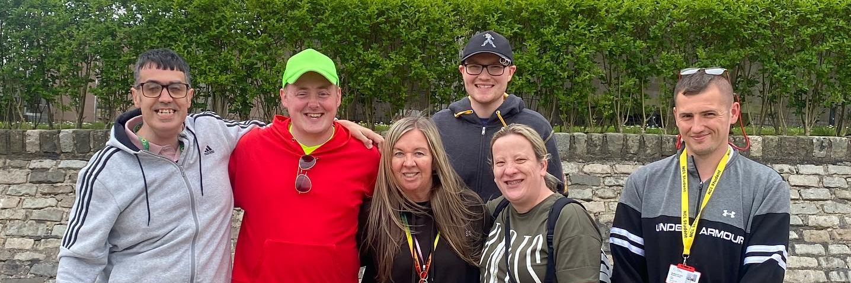
Super student engagement.
NCLSA student outreach efforts have been recognised after we were shortlisted for two awards.
New College Lanarkshire has been shortlisted in two categories in the sparqs’ 2023 Student Engagement Awards.
Outstanding Academic Representative
Kellyann McGraith has been nominated for her work as student president. During her two years in office as a president of the student association, Kellyann always went over and above and had the student at the centre.
Digital Partnership award
Working with MIS, we developed a way of using Teams that strengthened ‘the effectiveness of the Student Rep function and provided a platform for their voices to be heard on their terms’
This approach streamlines and increases accessibility for active dialogue for the student voice to be recorded. We feel we are only scratching the surface of the potential of these resources and look forward to harnessing its full capability in the new year.
sparqs’ 2023 Student Engagement Awards

Slide 8
Development of the course review.
The SA recently met with Jennifer Low - Assistant Principal: Education and Student Success and Barry Skea - Dean for Learning and Teaching to discuss the effectiveness of NCL’s current course review system and ace.
During the review process, the team tooked at operations of the course review overall to see what was working and what wasn’t and identified that there were many gaps in the review process.
After a long session, taking into account structural changes within the organisation, the team were able to devise a new system of operating which they feel will benefit both students and staff.
The structure, which was presented to and approved by Heads of Department and Academic Leaders, will hopefully increase student and staff engagement and make the student voice very much at the centre.
The team will be able to provide further updates once the new structure has been been implemented in the next few weeks.

Slide 9
NCLSA’s – It’s good to see you campaign.
NCLSA launched there new ‘Its good to see you’ campaign along with the promotion of their services to students. The NCLSA aim to raise their profile and also make sure students are aware of what services are available from their NCLSA.
These visuals are at every point a student can see within the campuses and also digital in classrooms.

Slide 10


Digital Screens
Campus posters

Slide 11
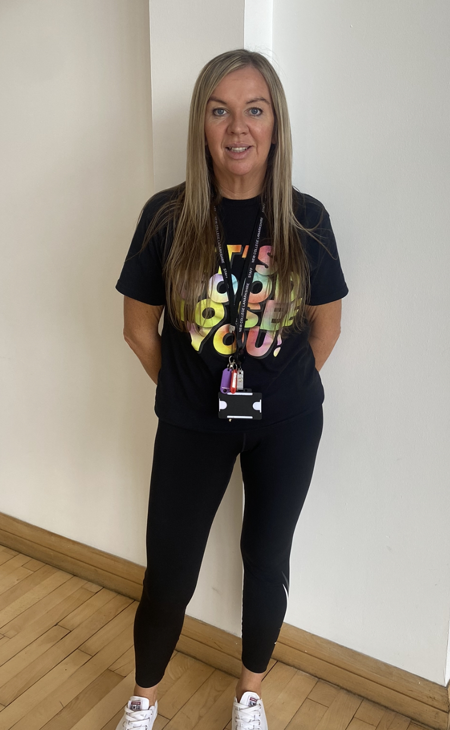
Active Campus Coordinator.
First in post across Scotland - Kellyann McGraith
A groundbreaking initiative aimed at promoting health and well-being among students in higher education delivered in partnership with sportscotland and Colleges Scotland.
Funded by sportscotland, the £1.45m investment will strengthen the existing network of sport and physical activity staff already working within the college sector through the appointment of new Active Campus Coordinators.
18 out of the 26 Scottish colleges have been given a new Active Campus Coordinator and NCL are fortune enough to be one of the 18.
In a two year action plan, Kellyann will work to increase participation opportunities for students and staff at NCL, improving physical and mental wellbeing.
Providing opportunities for everyone to lead more healthy active lives.. Kellyann is excited to fully immersing herself into the new role and over the coming months will:
Attend a residential stay at sportScotland Headquarters the other 17 active campus coordinators from across the sector to share ideas and best practice
Reach out to students and staff to gauge where the interest lies in sport and physical activity
Explore in house expertise to call upon for the delivery of sport and physical activity, whether that's within our student population or work force
Notes:
I am super excited about my new role, encouraging students and staff to participate in sport and physical activity, promoting health and well-being, providing opportunities for everyone to lead more healthy active lives as well as driving the Active campus plan alongside the other 17 active campus coordinators and colleagues from SportScotland and Scottish Student sport.
NCL were the first of Scottland's colleges to have our Active campus coordinator in place and I have had an initial meeting in Glasgow at SportScotland offices over the summer where I have already been able to network with SportScotland and SSS staff who will be supporting me in my new role.
We have a residential stay at SportScotland Headquarters in Inverclyde in November and all 18 Active campus coordinators will get to come together for a couple of days and share ideas and best practice.
Once welcome weeks are over with, I plan to fully immerse myself in my new role and will be reaching out to all students and all staff to gauge where the interest lies in sport and physical activity and see what kind of expertise we have in house that I may be able to call upon for the delivery of sport and physical activity, whether that's within our student population or work force.

Slide 12
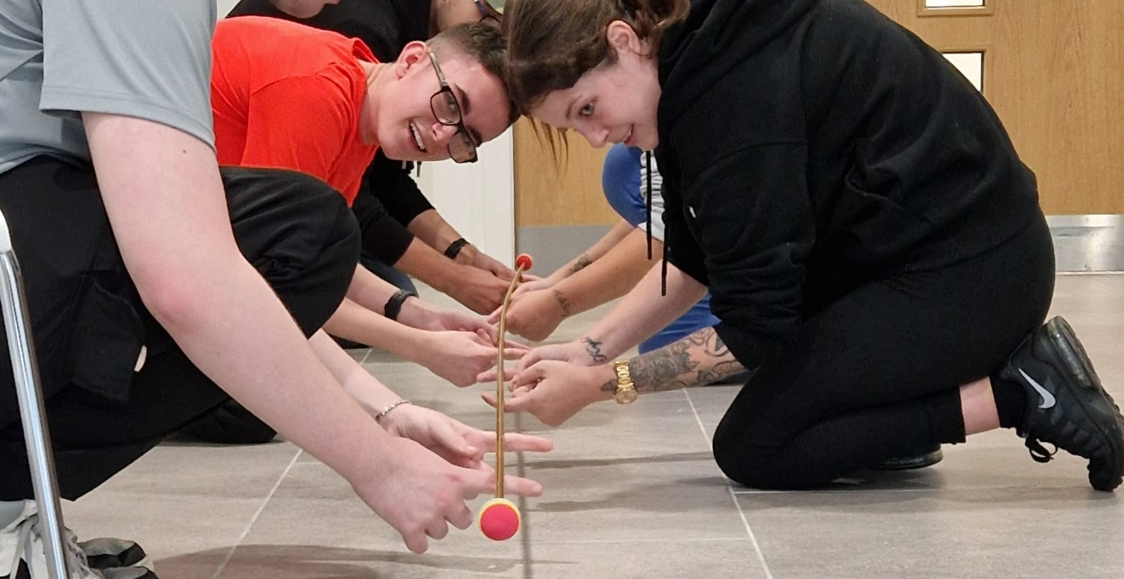
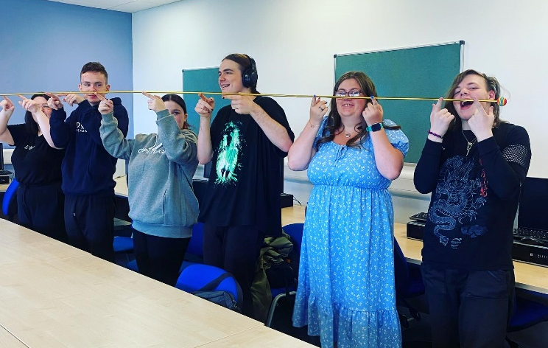
NCLSA Student Welcome.
NCLSA have decided this year to focus on supporting and preparing the student for their first couple weeks in the transition into college.
The team will be facilitating 2 weeks of fun team building events for students along with external agencies who will be delivering talks and information stalls.
Prepare to succeed team building.
Staff and students have been engaging well in selecting slots to attend.

Slide 13
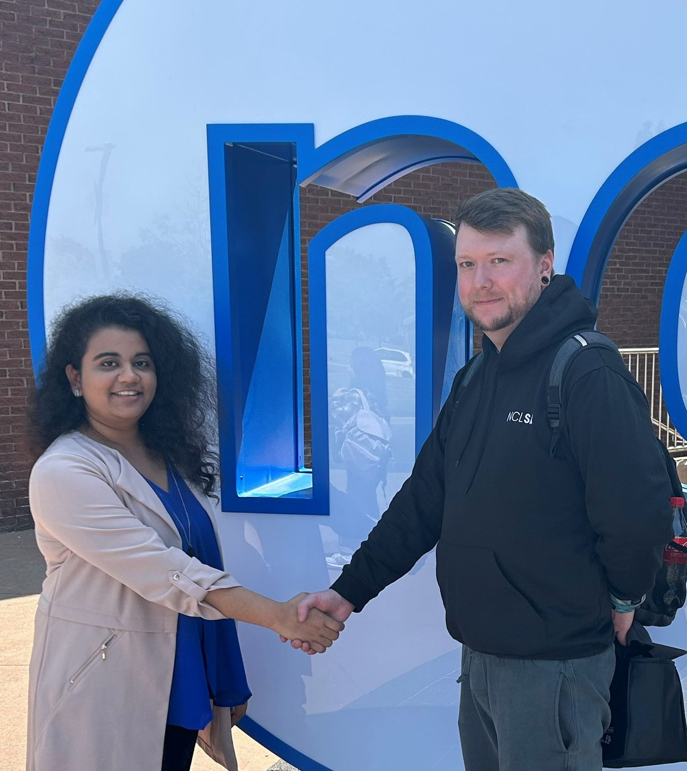
Building Canadian connections.
NCL Student President Mark Frame was part of a Turing trip who visited Canada's Niagara College earlier this Summer. Pictured here with Niagara college student President Depal, they agreed to continue to build the relationship between our two colleges through online meetings this year.
He was one of 22 students from NCL and four accompanying faculty who were in Niagara for a two-week customized study tour from May 26 to June 9. In addition to attending courses from ten different schools of study at NC, NCL students participated in workshops focused on Leadership, Equity, Diversity & Inclusion (EDI), Personal Brand, and Entrepreneurship/Intrapreneurship.
Mark said he hopes to implement in NCL what he has learned and experienced at NC.
“Niagara College actively creates opportunities for its students to better themselves, the environment, and the community,” - he said. “In my new role, I hope to create the same atmosphere NC radiated. Something that stuck with me was that NC openly stated the Land Acknowledgement during the seminars, showing the College not only cares about the future but also recognizes that the past plays a pivotal role.”
Senior Learning Engagement officer John O'Hara was also present and said 'I think this is a great partnership - NC has so many similarities to NCL and we can really benefit from this partnership. I think we might be the first College in Scotland to build partnerships with an international student union. It's a good energy!'
Our partnership with Niagara College started in March 2021, when we signed a three-year Memorandum of Understanding (MOU) intending to allow students, faculty, and staff the opportunity to benefit from best practices in education in Scotland and Canada. Students from Niagara visited NCL back in April and loved getting a feel for Scottish culture.

Slide 14
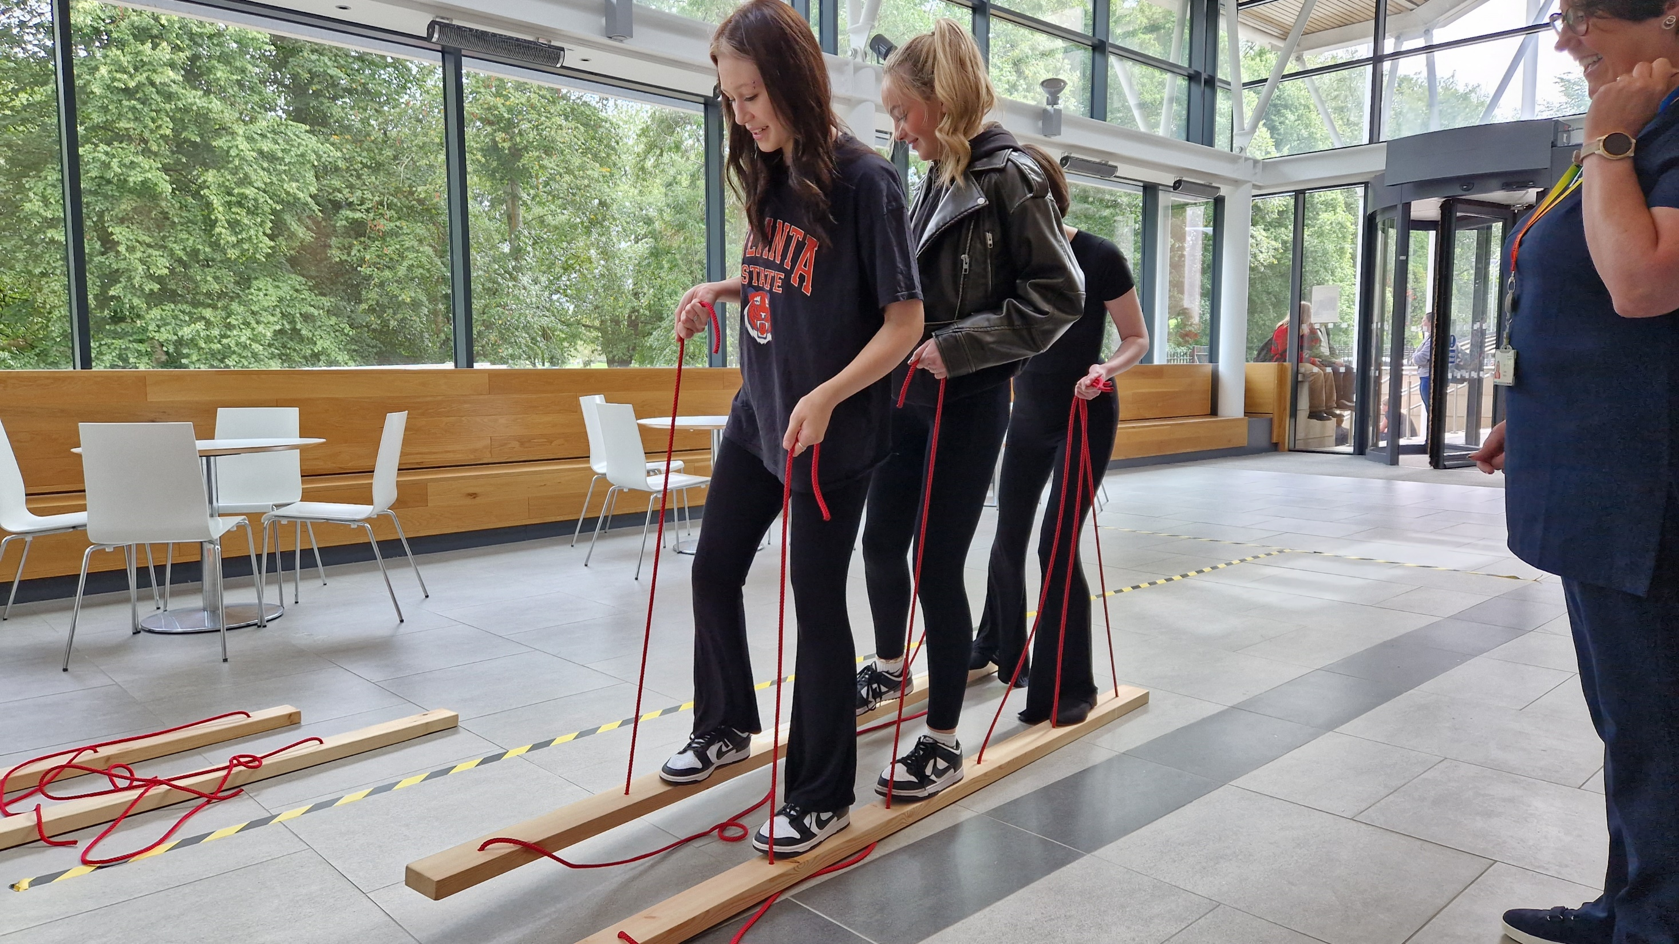
Join the conversation.
Facebook: NCLStudentVoice
Instagram: NCLStudentVoice
Twitter: NCLStudentVoice
Email: studentvoice@nclan.ac.uk

