Slide 1

Students’ Association and Student Voice.
April 2024 Board Report.

Slide 2

The future is bright.
Met the NCLSA Student Presidents.
A total of 226 votes were cast online by students across all campuses for our 7 candidates and the winning presidents.
Starting strong
2024 – 2025 term will see new student presidents welcome our full-time August start students:
Chloe Sandilands (NQ Computing Science) – Motherwell Campus
Karen Calpin (NQ Art and Design) – Coatbridge Campus
Julie Webster (NC Psychology) – Cumbernauld Campus
Video interviews will be created during the summer in preparation for the new term. Our aim is to ensure each president is visible to the student body.

Slide 3
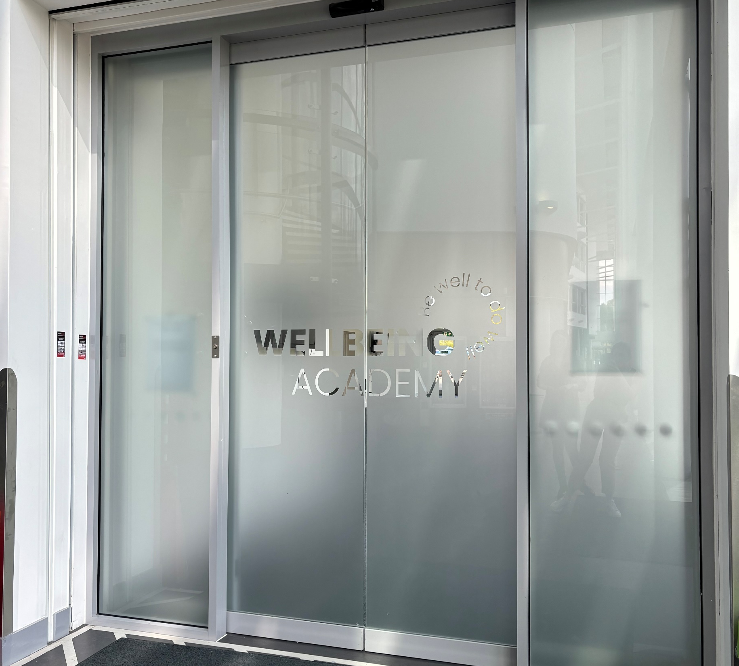

At New College Lanarkshire (NCL) the correlation between wellbeing and student withdrawal is significant. It is noted that students who struggle with wellbeing issues such as stress, anxiety, depression, or physical health are challenged by the demands of their programme of study and, therefore, are likely to withdraw from their course.
To support students to improve their wellbeing and remain on their programme of study, NCL has invested in three Wellbeing Academies (WA’s) situated in each of our main campus sites, Coatbridge, Cumbernauld, and Motherwell. The Academies are a pioneering initiative designed to prioritise wellbeing at the core of the student experience.
Recognising the critical link between student wellbeing and academic success, the WA’s aim to provide holistic support services and programmes that cater to the physical, emotional, and social wellbeing needs of our students. By doing so, it seeks to enhance student retention, academic performance, and overall satisfaction, aligning with NCL's Getting to Know You and Be Financially Fit campaigns and our Recruitment and Retention Strategy.

Slide 4

May marvel.
Celebration of success.
The Students’ Association and Learner Engagement team are excited to announce an awards lunch at our MLOne Training Restaurant, where we'll partner with hospitality events students to honour the outstanding achievements of our class representatives who have gone above and beyond their responsibilities.
We look forward to sharing the details of the lunch in our next board update.

Slide 5
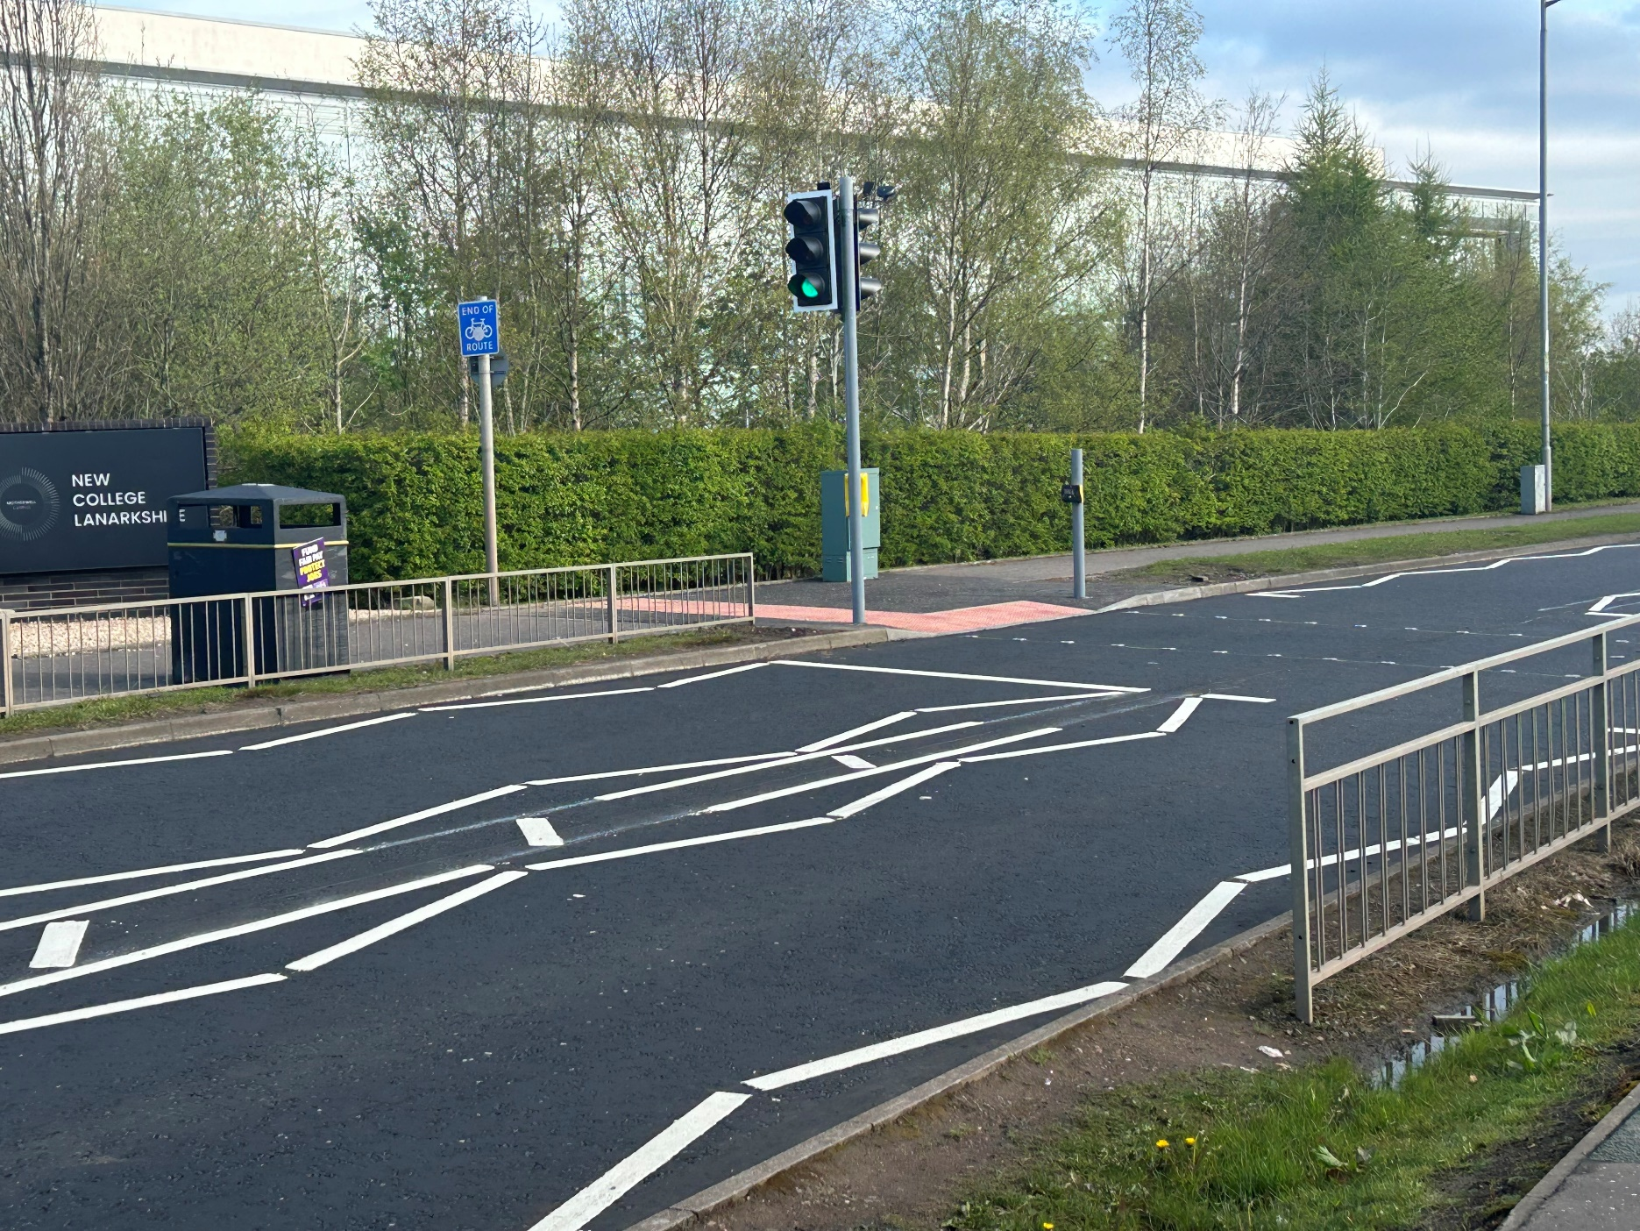
Enhancing campus safety.
After the former Students’ Association President expressed concerns to MP Marion Fellows regarding unsafe pedestrian crossings at our Motherwell Campus, students and members of the local communities now have safer routes for walking or biking into neighbouring areas.
This month sees the introduction of enhanced safety measures.

Slide 6
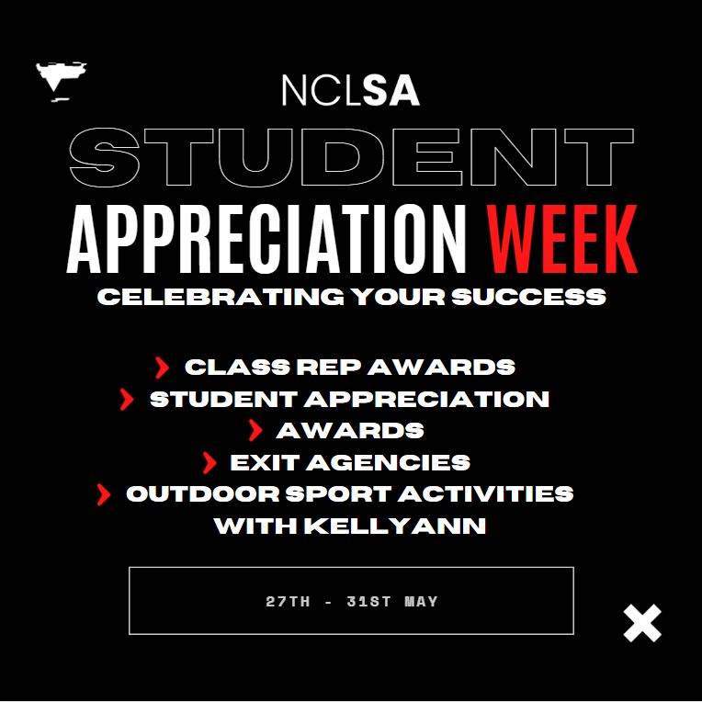
Student Appreciation Week is a time dedicated to honouring and celebrating the invaluable contributions of students within our academic community.
Throughout the week, various Award Ceremonies will take place to celebrate all the hard work, dedication, and achievements of our students.
It's an opportunity for departments, staff, and peers to come together and recognise the positive impact students have on campus life.
From special recognition ceremonies to small gestures of appreciation, Student Appreciation Week serves as a reminder of the importance of students and their role in shaping NCL for the future.
Awards include:
Excellence in schools award: We are looking for Schools Partnerships that have students overcome a challenging period or simply worked tirelessly to do over and above there course such as competitions or projects they have been involved in – this might even be a schools pupal who has shown the most development over the past year.
Learner of the year award: The Learner of the Year category recognises individuals who are developing themselves through College and making positive improvements to their lives.
Against All Odds Award: Designed to recognise learners who have overcome difficult personal circumstances in order to succeed in their studies,
Skills competitor award: This award is for student have entered industry awards that are related to the department this ward should be a student who has excelled and competed in the last year.

Slide 7
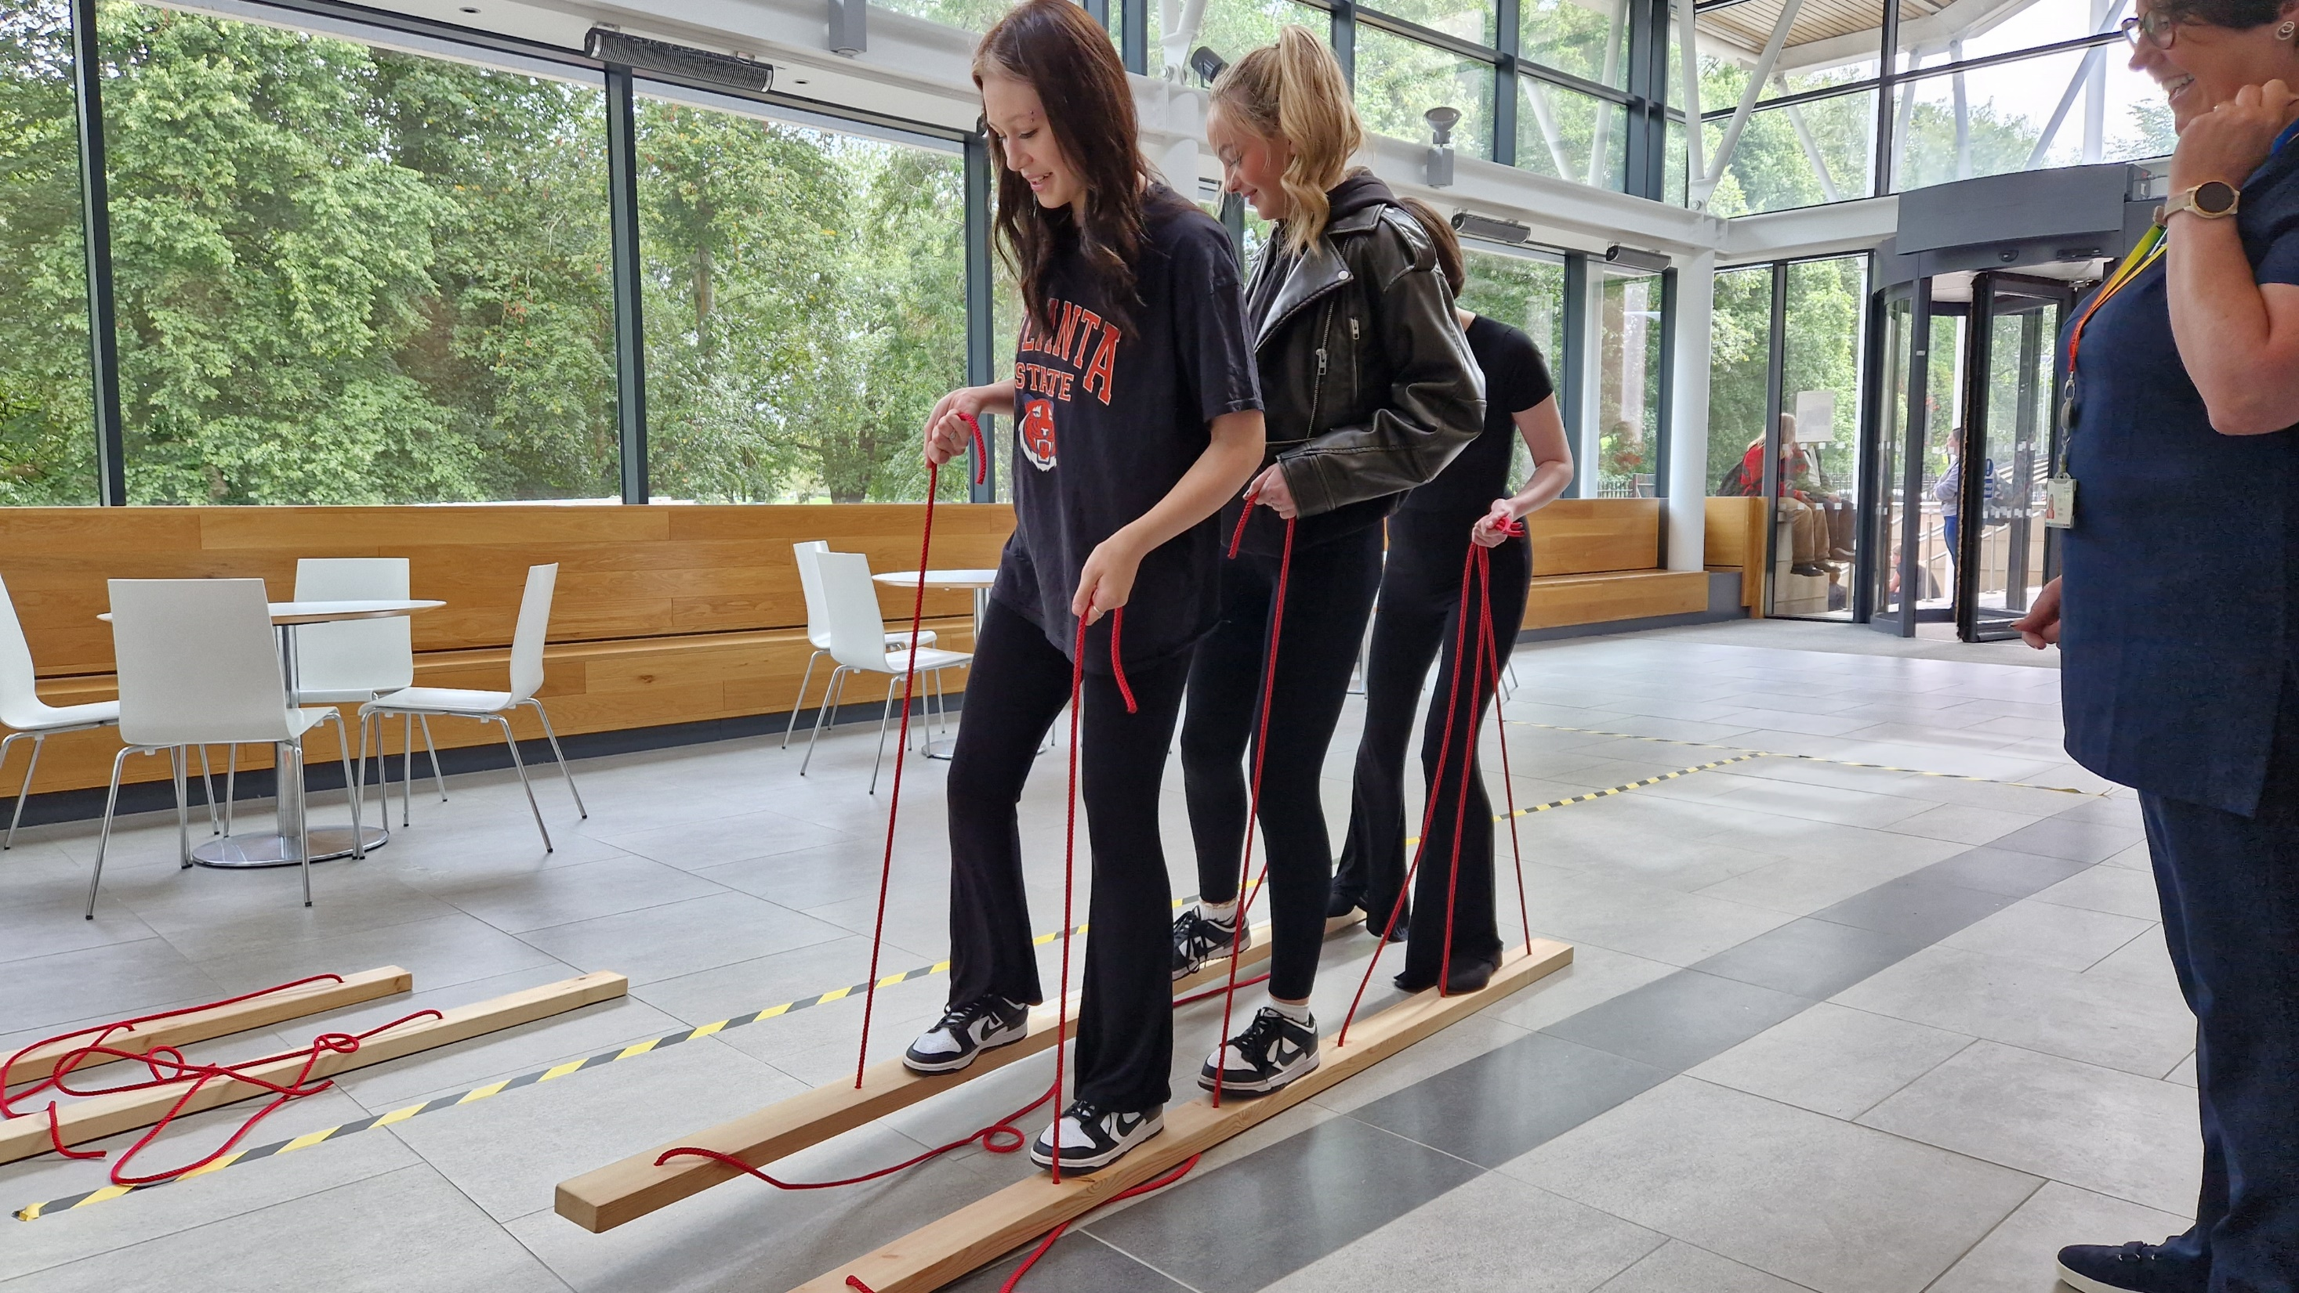
Join the conversation.
Facebook: NCLStudentVoice
Instagram: NCLStudentVoice
Twitter: NCLStudentVoice
Email: studentvoice@nclan.ac.uk

